Slide 1
Использование зебраданио для моделирования заболеваний человека
Д.б.н., профессор РАН Калуев А.В.
V Международный форум по когнитивным наукам
9.12.2022, Yekaterinburg

Slide 2

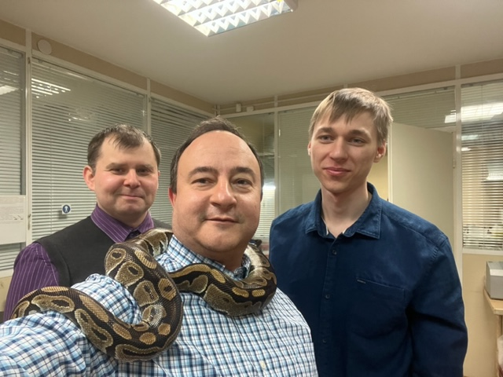




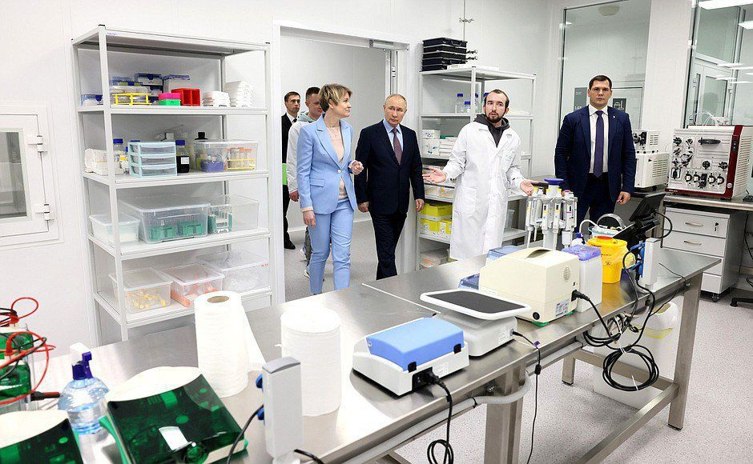


Уральский федеральный университет
СПбГУ
Университет ”Сириус”
НИИ нейронаук и медицины и НГУ
НМИЦ им. В.А. Алмазова МЗ РФ
МФТИ
РНЦ РХТ им. акад. Гранова МЗ РФ

Slide 3
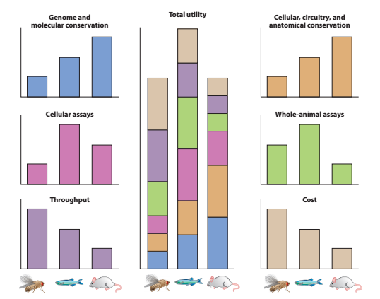
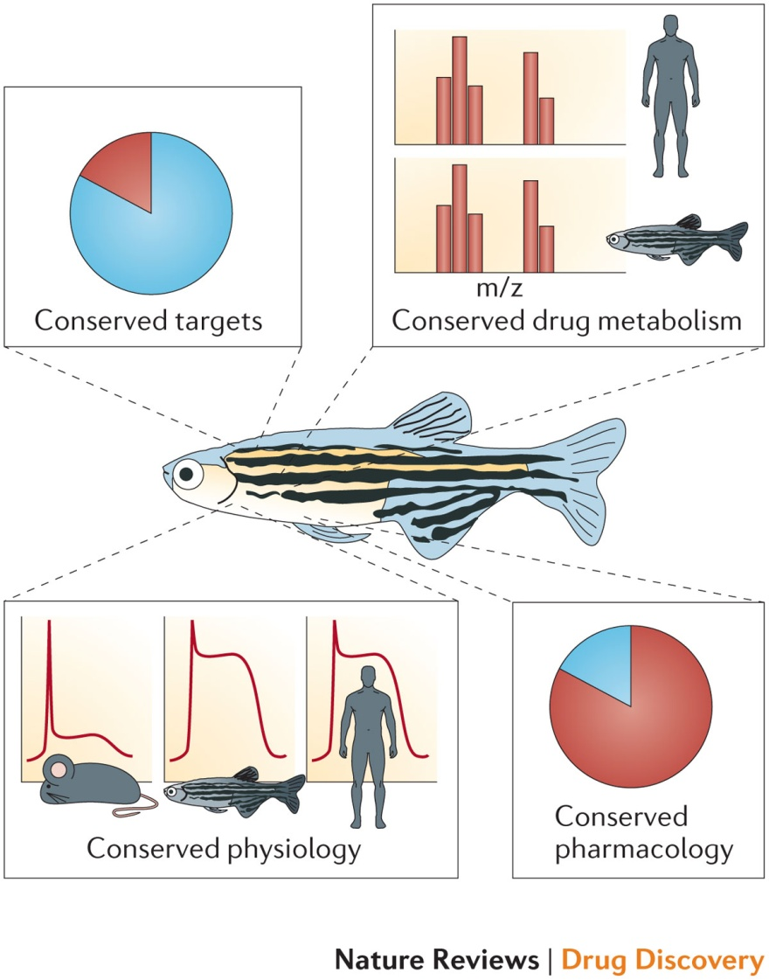
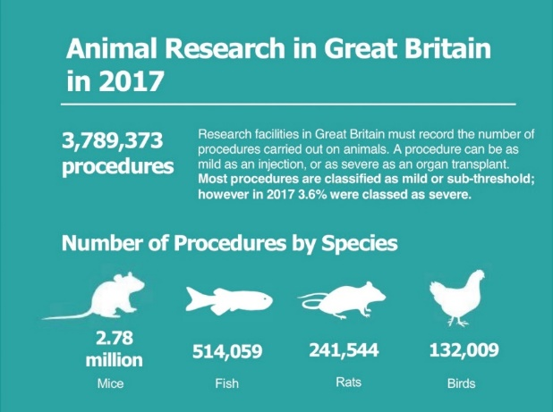
Zebrafish as a model
MacRae & Peterson, 2015

Slide 4
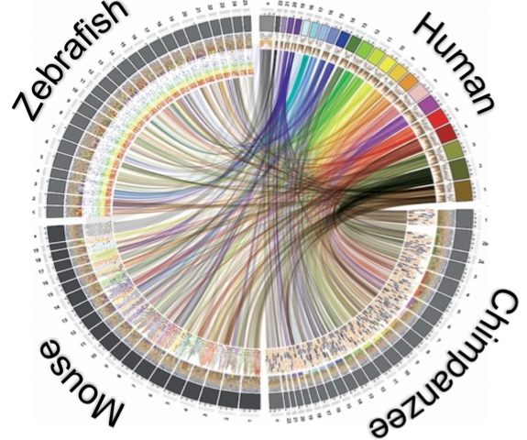
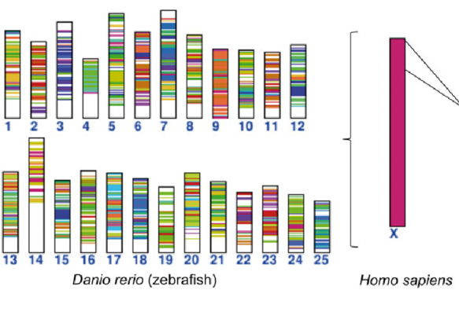

Zebrafish as a genetic machine
25
23
NIH, 2016
Stewart et al 2014
Genetic homology
Veitia et al. 2015

Slide 5

Zebrafish as a time machine
400 M 300 M 70 M
years ago years ago years ago
Stewart et al 2014

Slide 6
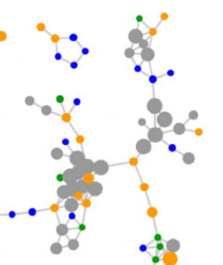

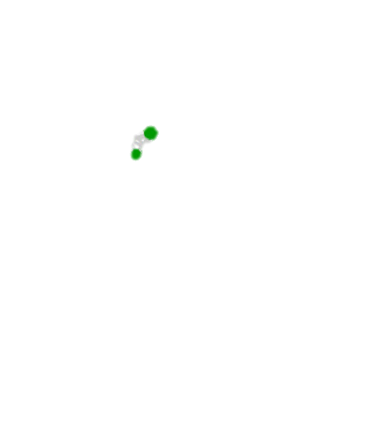
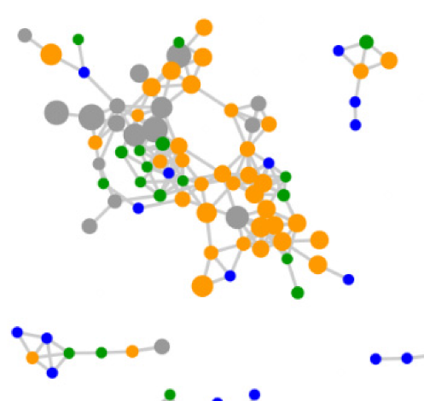
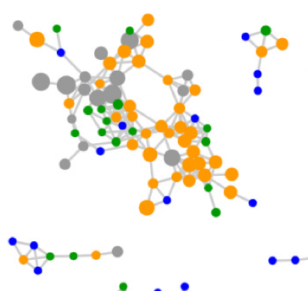

Zebrafish as a translational machine
CNS pathogenesis
Evolutionarily conserved, core pathogenesis
400 M y.a. 300 M y.a 70 M y.a.

Slide 7
Zebrafish as a translational machine
Stewart et al 2014

Slide 8
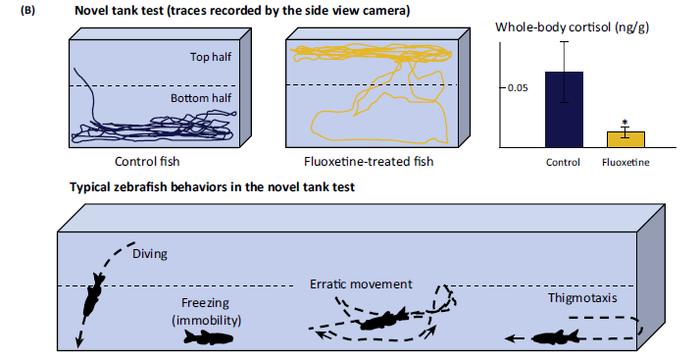
CNS diseases: Anxiety
Stewart et al 2014

Slide 9
How can we use this powerful biological machine in neuroscience research?

Slide 10
Aim: To understand neuroendocrine mechanisms and identify novel drug targets

Slide 11
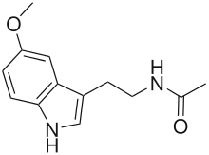
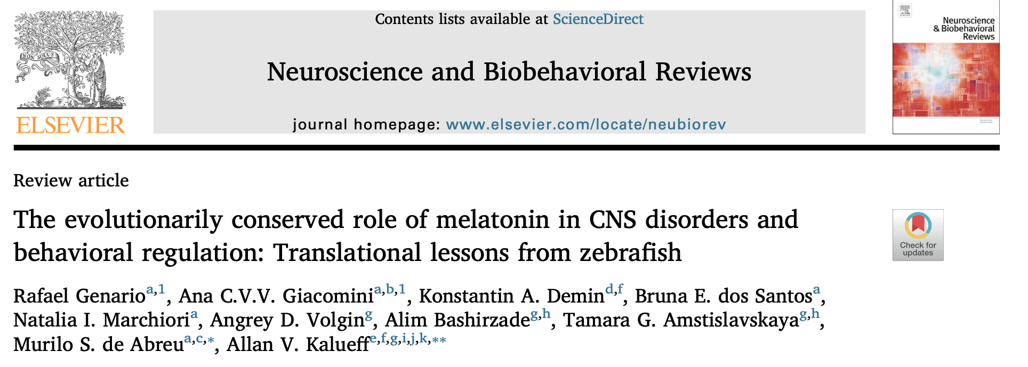
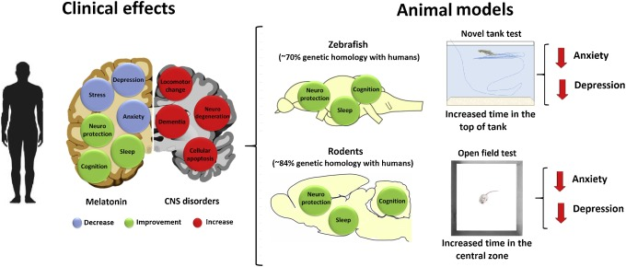
Melatonin CNS effects

Slide 12
Anxiolytic effects of melatonin in zebrafish
Effects of melatonin 24-h treatment (0.232 mg/L) in adult zebrafish under light housing, tested in the 15-min novel tank test. U-test (n = 20) vs. controls.
Genario et al., 2019

Slide 13



Melatonin-related molecules are an evolutionarily conserved target for anxiolytic effects across taxa
New anxiolytic drugs can be developed by targeting melatonin signaling pathways

Slide 14
Aim. To expand the range of molecular models using zebrafish behavioral research and chronic stress models
Q: Can we use zebrafish to model stress-related molecular processes?
Zebrafish as molecular machines

Slide 15
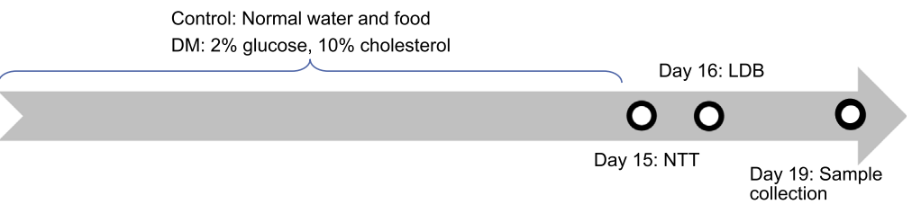
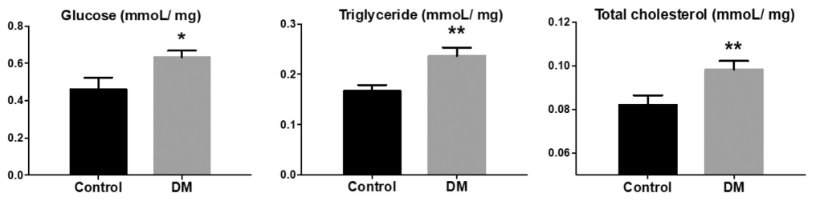
Zebrafish models of diabetes DM type 2

Slide 16
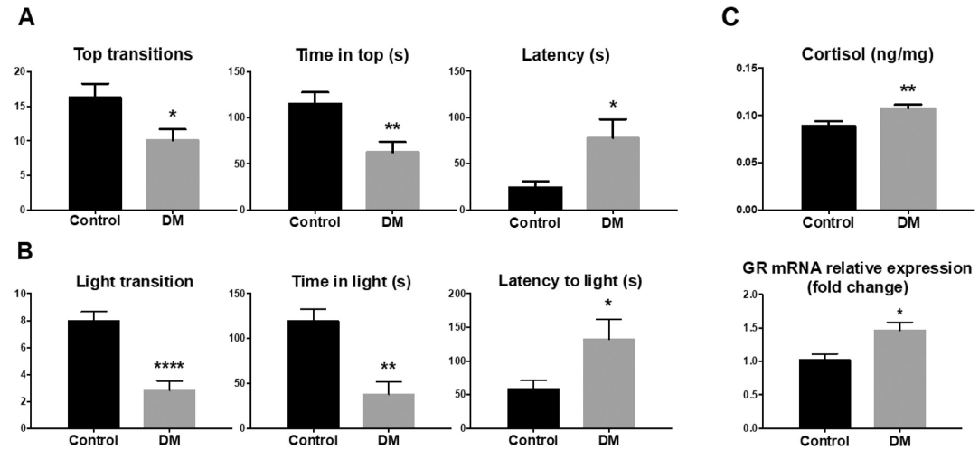
Robust DM-induced anxiety in zebrafish on day 15/16

Slide 17
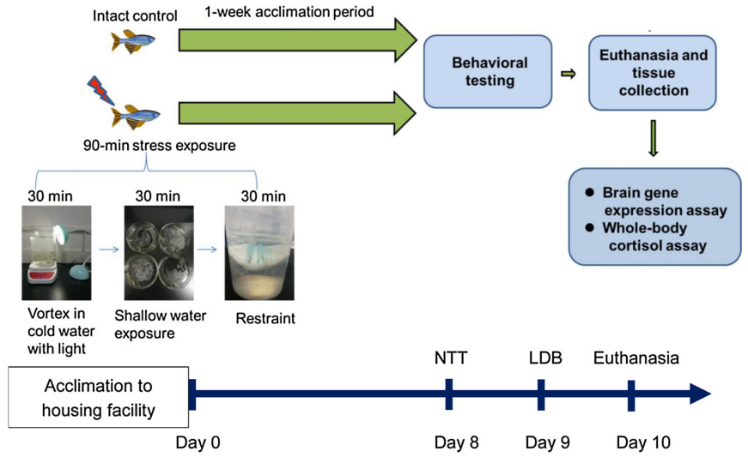
PTSD Modeling in zebrafish

Slide 18
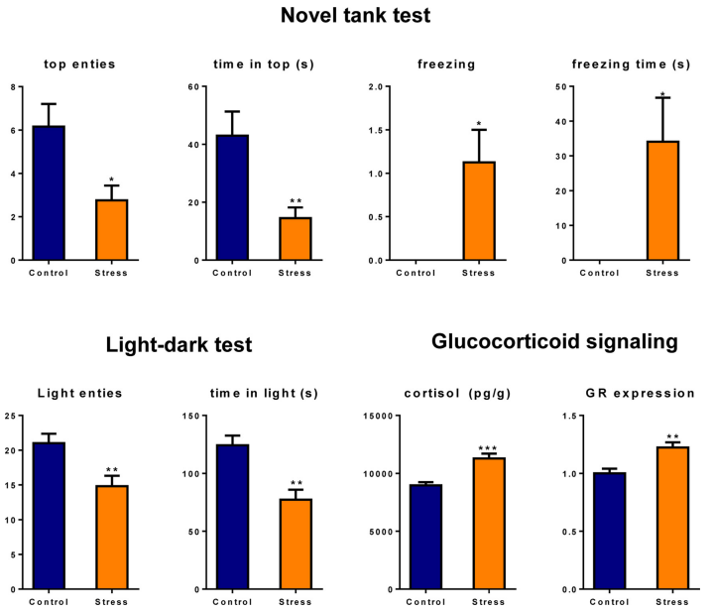
Model validation: robust PTSD-like phenotype

Slide 19
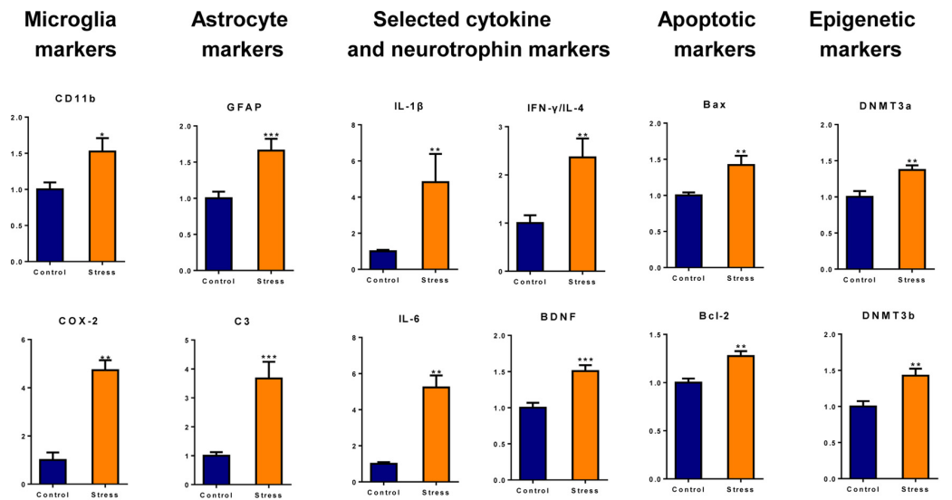
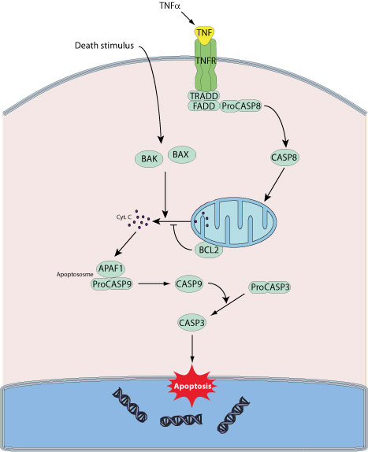
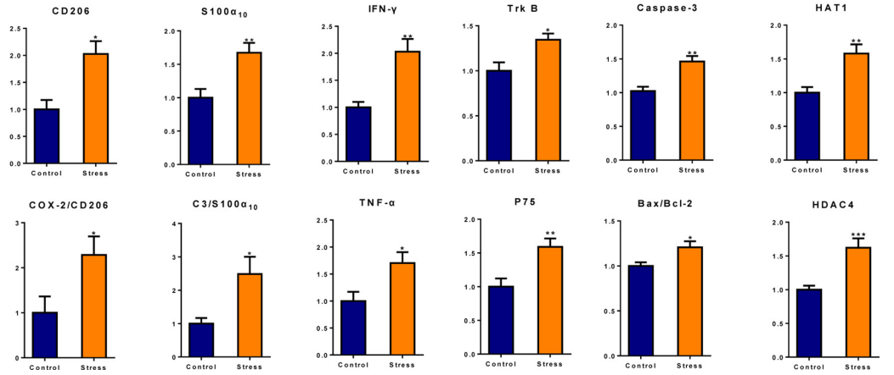
Molecular biomarkers in the brain
↑
↑
↑

Slide 20
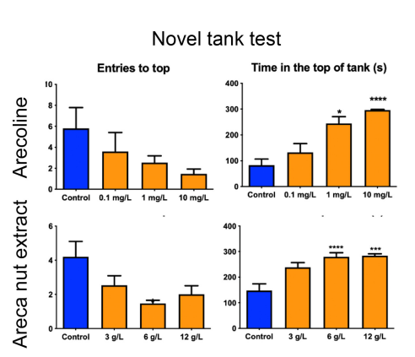
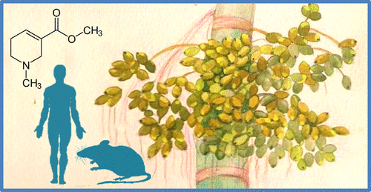
Chronic arecoline

Slide 21
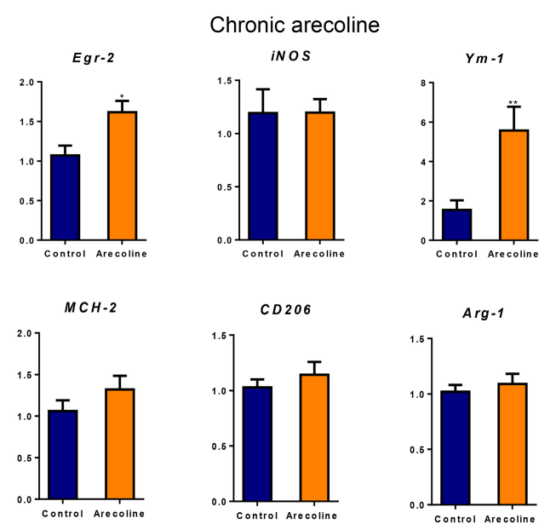
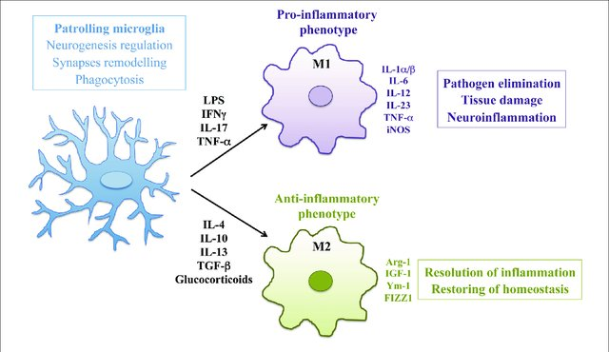
Arecoline activates neuroprotective M2- microglia
↑

Slide 22
Aim. To expand the range of molecular models using zebrafish behavioral research and chronic stress models
Q: How do zebrafish chronic stress responses develop over time?
Zebrafish as molecular machines

Slide 23
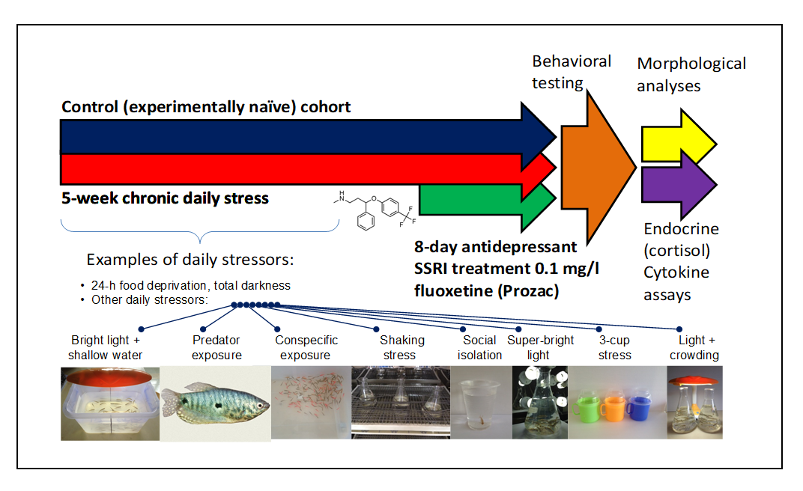
Model of chronic stress in zebrafish

Slide 24
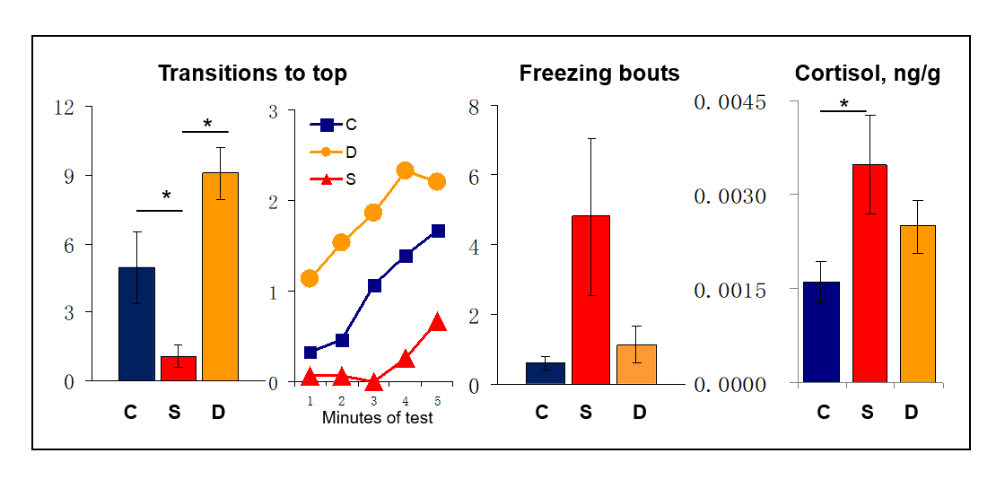
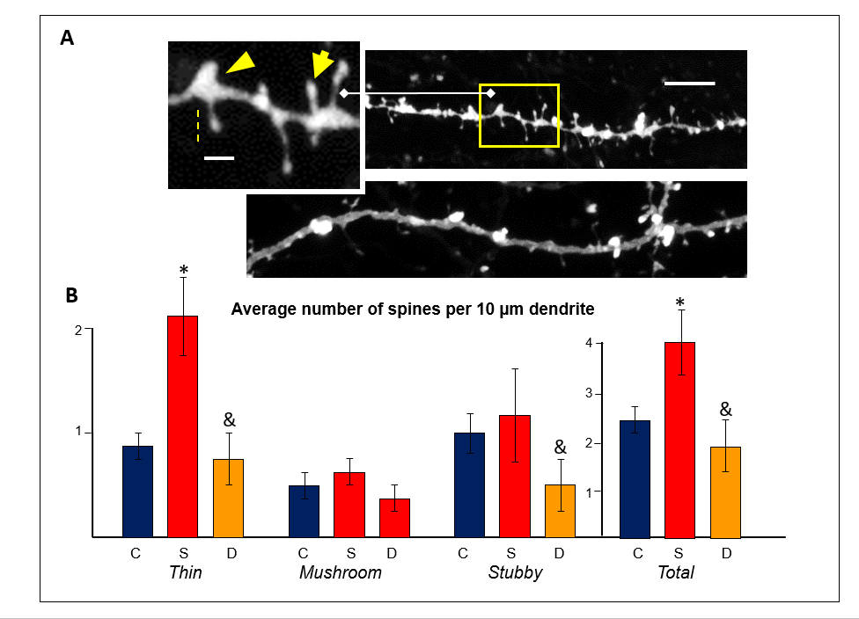
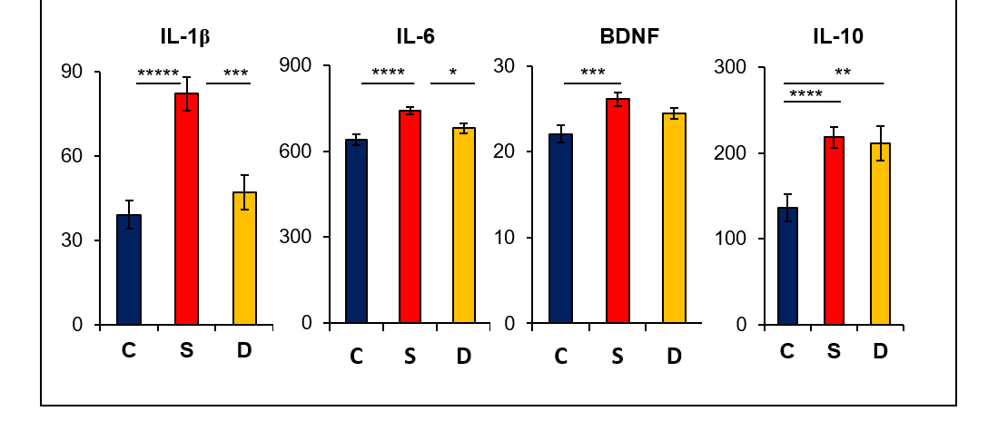

Slide 25
Aim. To apply artificial intelligence tools to understand and predict CNS drug properties
Q: Can we use zebrafish screens to study NOVEL CNS drugs?
Smart Zebrafish

Slide 26
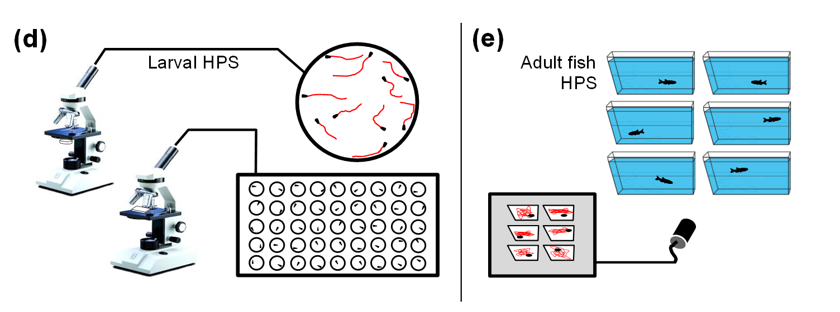
High-throughput drug screening
>10 000 drugs/day

Slide 27
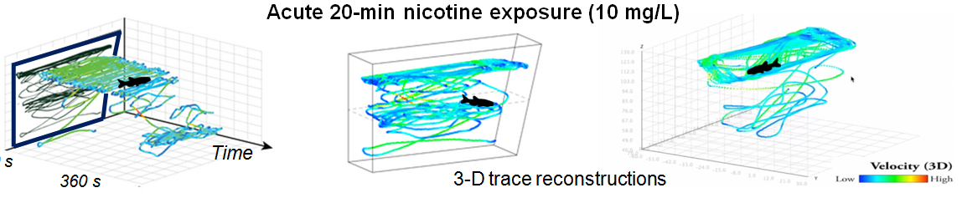
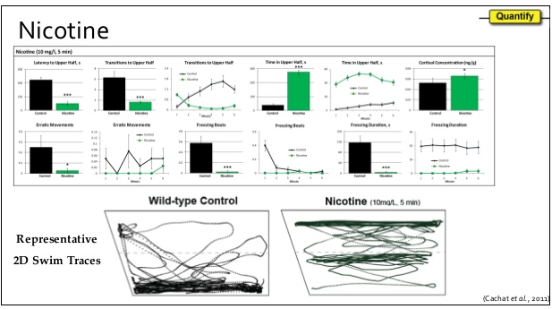
Acute micotine (10 mg/L) effects

Slide 28
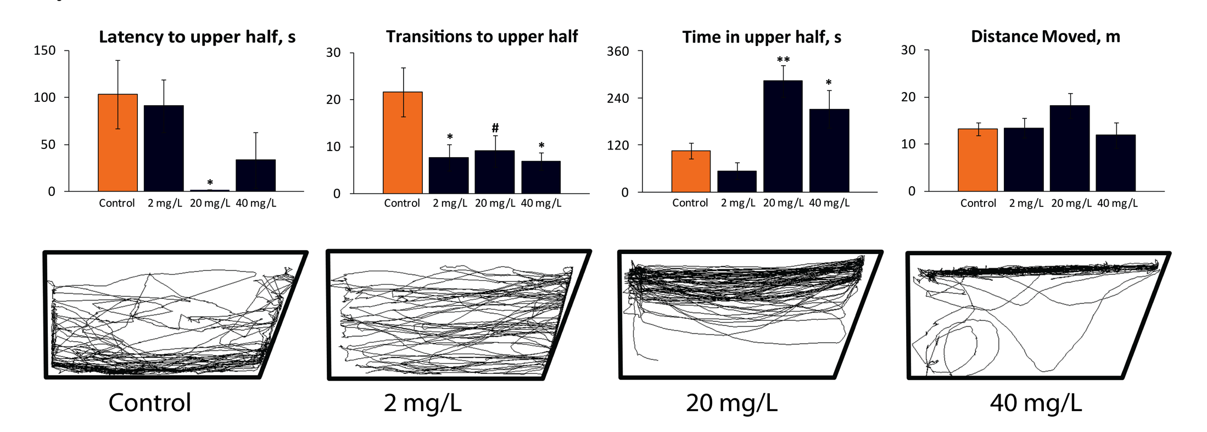
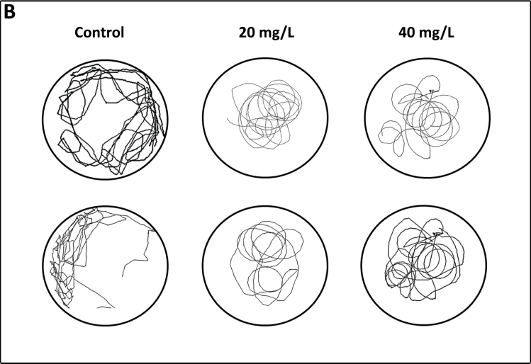
Acute ketamine effects
Strong anxiolytic effect at 20 and 40 mgL
Stereotyped circling behaviors at higher doses, on horizontal plane – not visible from front view (2D), requires 3D reconstruction
Kyzar et al. 2012

Slide 29
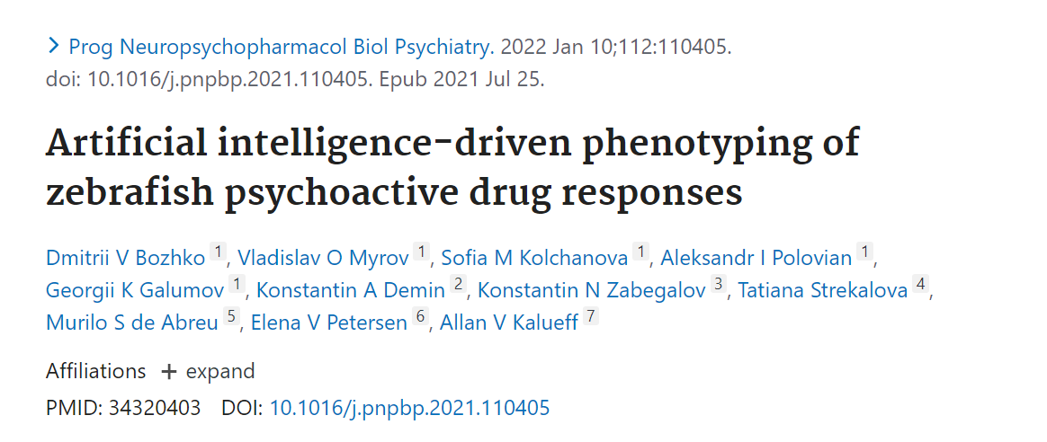
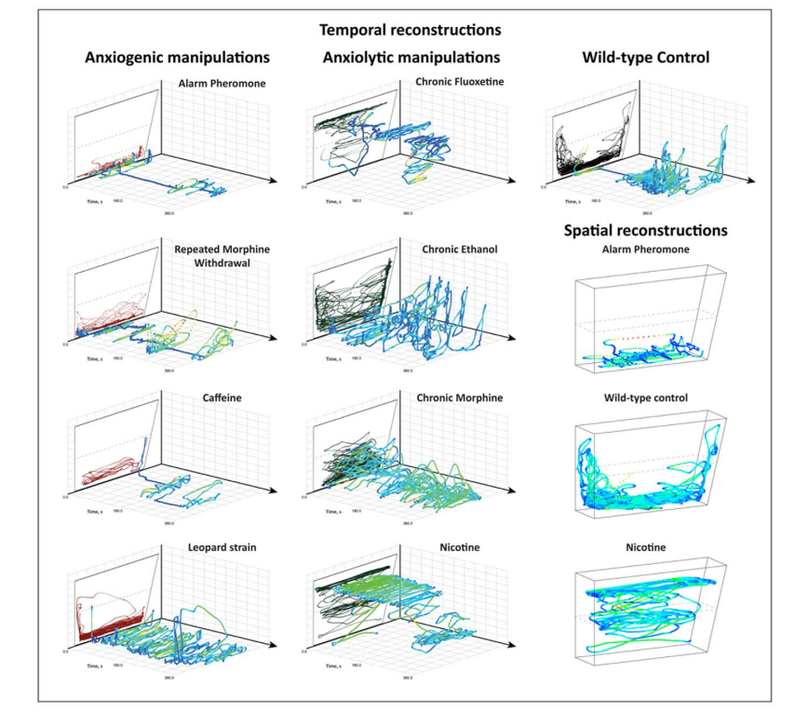

First application of Artificial Intelligence (AI) to zebrafish CNS models
Here, we applied the artificial intelligence (AI) neural network-based algorithms to a large dataset of adult zebrafish locomotor tracks collected previously in a series of in vivo experiments with multiple established psychotropic drugs.
We first trained AI to recognize various drugs from a wide range of psychotropic agents tested, and then confirmed prediction accuracy of trained AI by comparing several agents with known similar behavioral and pharmacological profiles.

Slide 30
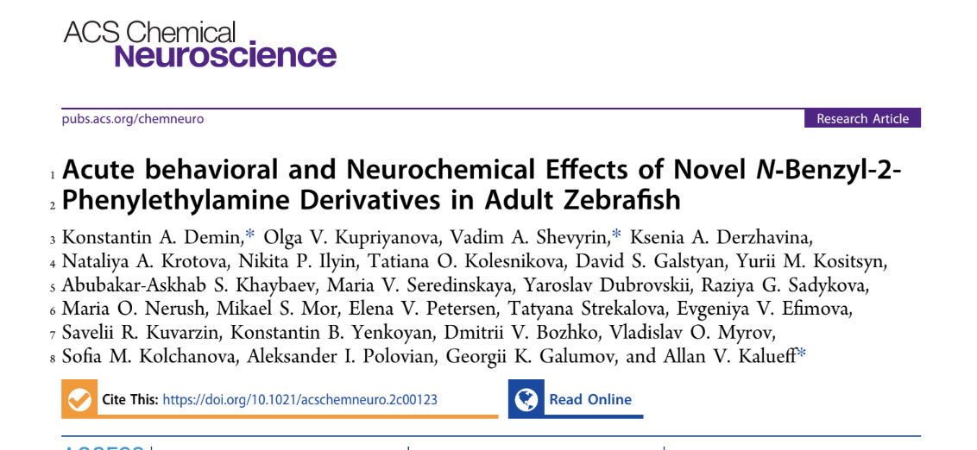
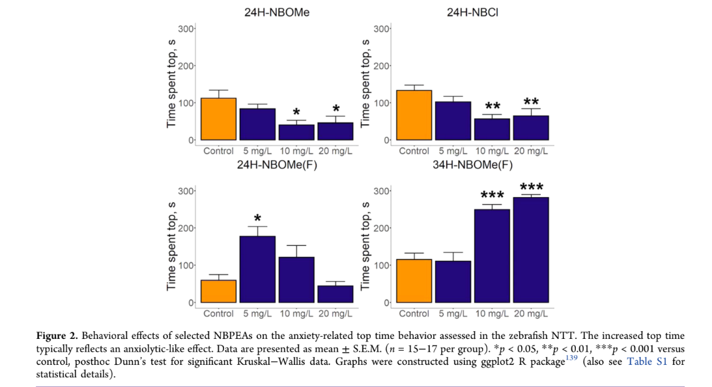
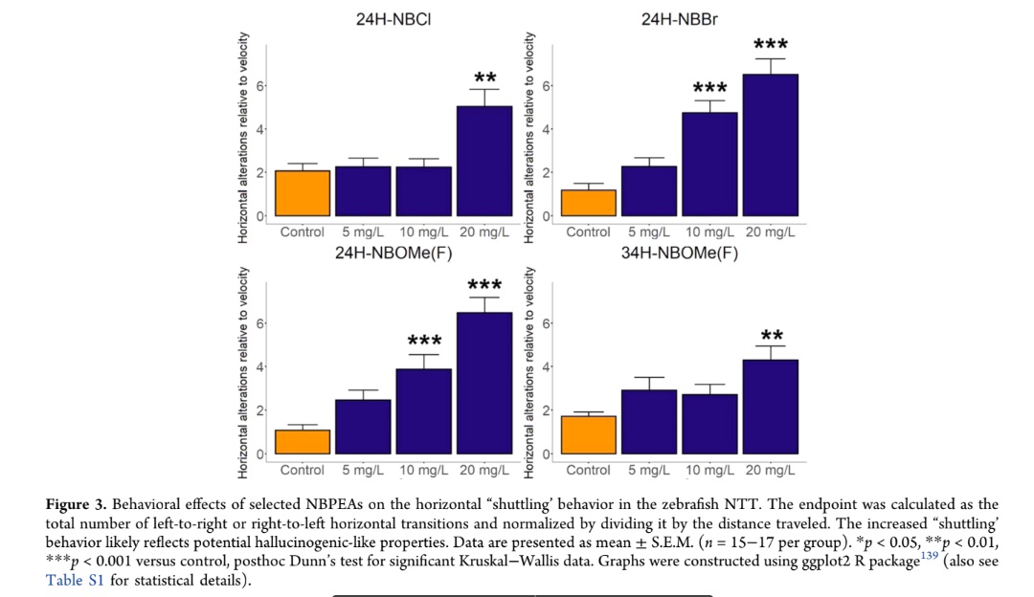
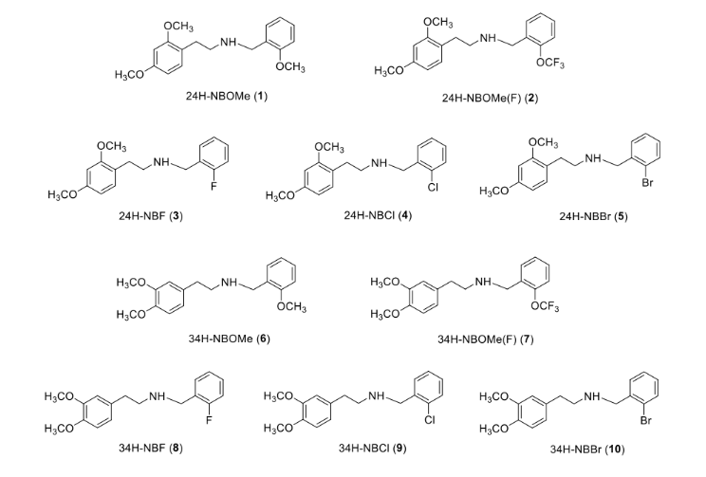
Here, we test a battery of ten novel N-benzyl-2-phenylethylamine (NBPEA) derivatives with the 2,4- and 3,4-dimethoxy substitutions in the phenethylamine moiety and the −OCH3, −OCF3, −F, −Cl, and −Br substitutions in the ortho position of the phenyl ring of the N-benzyl moiety, assessing their acute behavioral and neurochemical effects in 18 the adult zebrafish

Slide 31
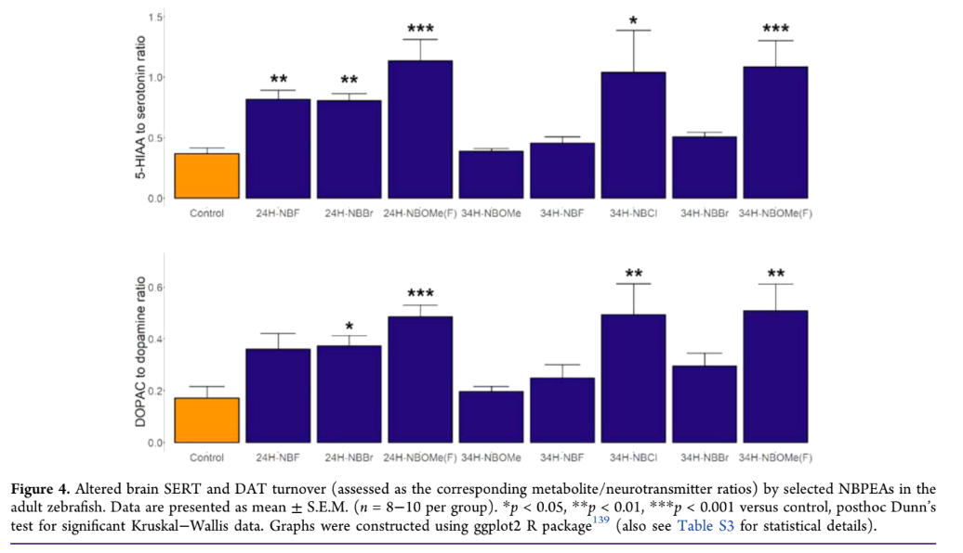
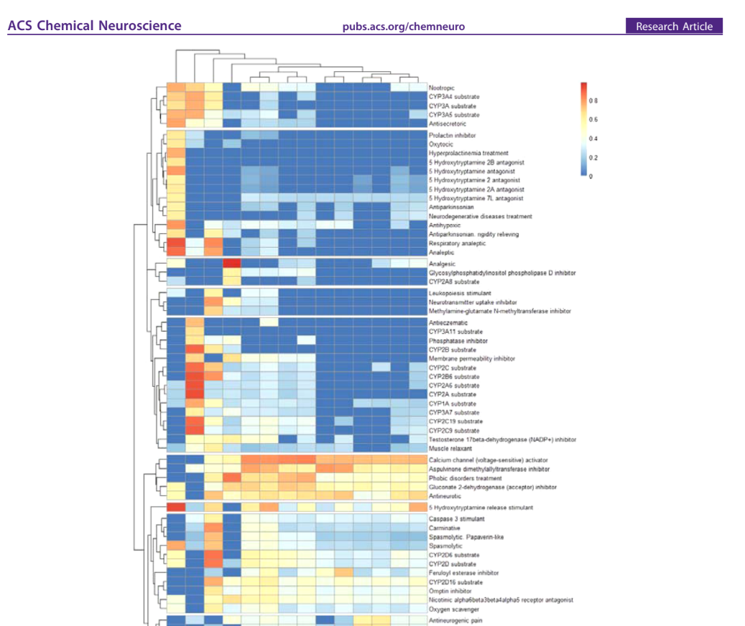
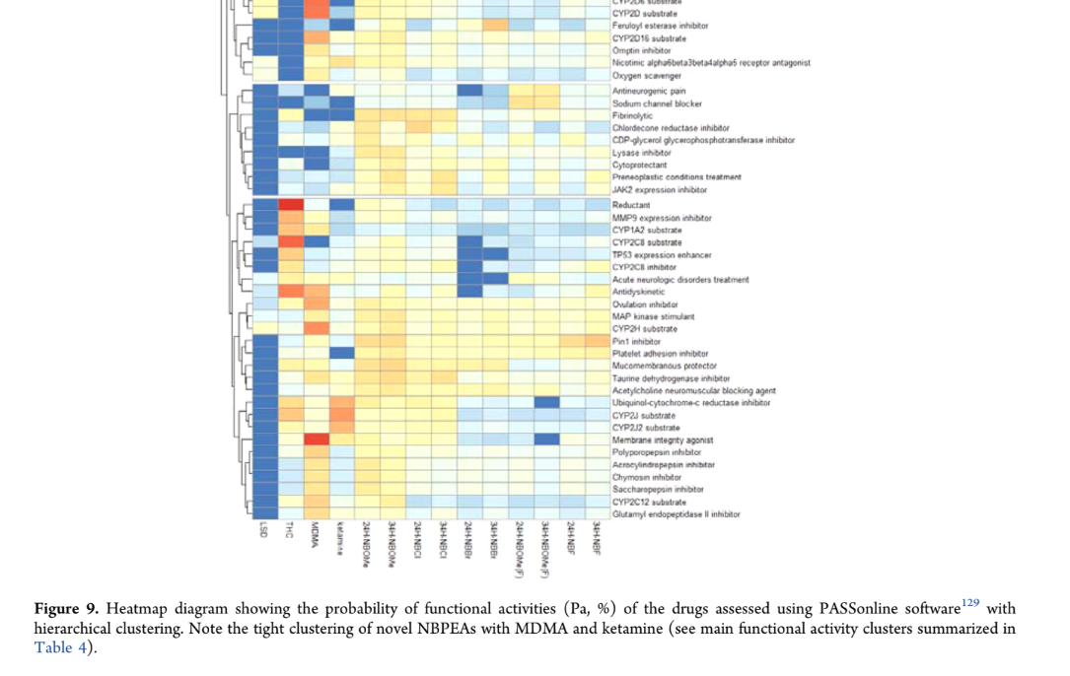
Overall, substitutions in the N-benzyl moiety modulate locomotion, and substitutions in the phenethylamine moiety alter zebrafish anxiety-like behavior, also affecting the brain serotonin and/or dopamine turnover.
Computational analyses of zebrafish behavioral data by artificial intelligence identified several distinct clusters for these agents, including anxiogenic/hypolocomotor (24H−NBF, 24H−NBOMe, and 34H− NBF), behaviorally inert (34H−NBBr, 34H−NBCl, and 34H−NBOMe), anxiogenic/hallucinogenic-like (24H−NBBr, 24H−NBCl, 24 and 24H−NBOMe(F)), and anxiolytic/hallucinogenic-like (34H−NBOMe(F)) drugs.
Our computational analyses also revealed phenotypic similarity of the behavioral activity of some NBPEAs to that of selected conventional serotonergic and antiglutamatergic hallucinogens.
In silico functional molecular activity modeling further supported the overlap of the drug targets for NBPEAs tested here and the conventional serotonergic and antiglutamatergic hallucinogens.

Slide 32
Conclusions
Zebrafish are powerful biological machines for neuroscience research
These models allow us:
1) to measure (=objectively quantify) behavioral deficits
2) to parallel behavioral data with endocrine profiling (e.g., cortisol, melatonin)
3) to develop models based on newly recognized behavioral domains
4) to identify ‘core’ (evolutionarily conserved) candidate molecular targets
5) to assess biological consequences of chronic stress
7) 8) to identify novel potential molecular cascades (e.g., omics data)
9) to screen novel CNS drugs and predict their properties
11) to develop novel AI-based models and tools to identify novel drugs

Slide 33


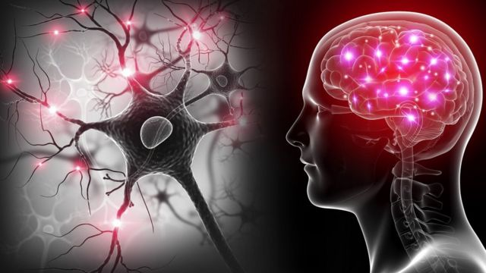
Магистратура «Нейробиология»
Направление подготовки: 06.04.01 Биология
Цель программы: подготовка высококвалифицированных специалистов, владеющих знаниями и навыками в области нейробиологии, для работы в крупных научных центрах, университетах и нейротехнологических и фармакологических компаниях.
Форма обучения: очная Срок обучения: 2 года
Программа «Нейробиология» позволяет осуществлять формирование образовательных сред; индивидуальных образовательных маршрутов за счет трех специализаций:
трансляционная нейробиология,
когнитивная нейробиология,
нейробиомеханика
Notes:
Нейробиология — наука, изучающая устройство, функционирование, развитие, генетику, биохимию, физиологию и патологию нервной системы. Изучение поведения является также разделом нейробиологии.
Нейробиология занимается огромным спектром вопросов – начиная с вопросов поведения, ВНД, заканчивая молекулярными и генетическими процессами функционирования и развития мозга

Slide 34
THANK YOU!

