Slide 1
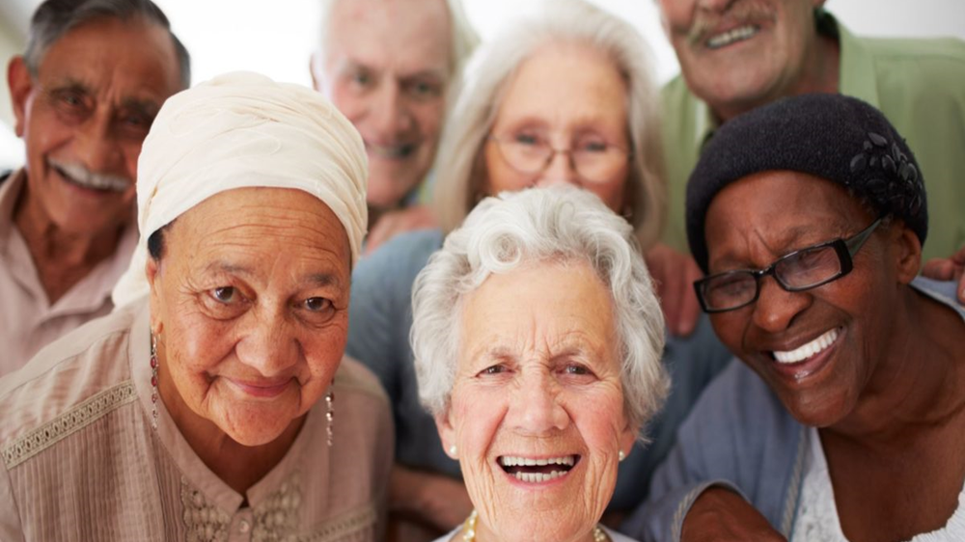
MITIGATING THE
UNWANTED CHANGES IN
THE ELDERLY
*Theophilus Lazarus, PhD & **Gershom T. Lazarus, PhD
Dept of Psychology, Emory University, Atlanta, GA, USA.;
*Private Practice (South Africa); **Private Practice, Atlanta, GA.
Webinar presented at Cognitive Neuroscience Conference, Yekatirinburg, Russia, December 9-10, 2022

Slide 2
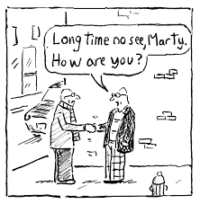
The aging process
Biological Aging
Genetic Basis
Psychological

Slide 3
Stress/Stimulus
Protective variants in genes influence resilience – Modulation of sensitivity to environment, stress response, and amygdala/hippocampal threat activation
Epigenetics/Gene Expression
Genetic
Resilient phenotypes regulated by molecular pathways
Subsequent ↓ epinephrine
Molecular
↑ epinephrine
Continued ↑ epinephrine
ANS
Subsequent ↓ cortisol
↑ cortisol
Physiological
Continued ↑ cortisol release
Endocrine
↑ pro-inflammatory cytokines
Subsequent ↓ pro-inflammatory cytokines
Immune System
Excess ↑ pro-inflammatory cytokines
Neurological/
Neuropsychological
CNS
Fronto-limbic circuitry
Emotion regulation, cognitive control
Emotion dysregulation, poor cognitive control
↑ Optimism
↑ Coping Self-Efficacy
↓ Levels of Anxiety
Personality, appraisal, coping, resilience, anxiety, optimism
Resilience to psychological stressors
Psychological/
Behavioral
↓ Optimism
↓ Coping Self-Efficacy
↑ Levels of Anxiety
Depression, anxiety, and trauma symptoms (fear of illness and death, uncertainty about the future)

Slide 4
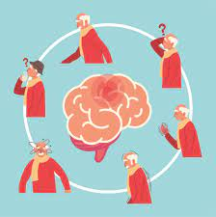
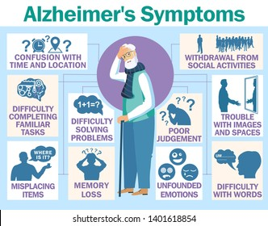
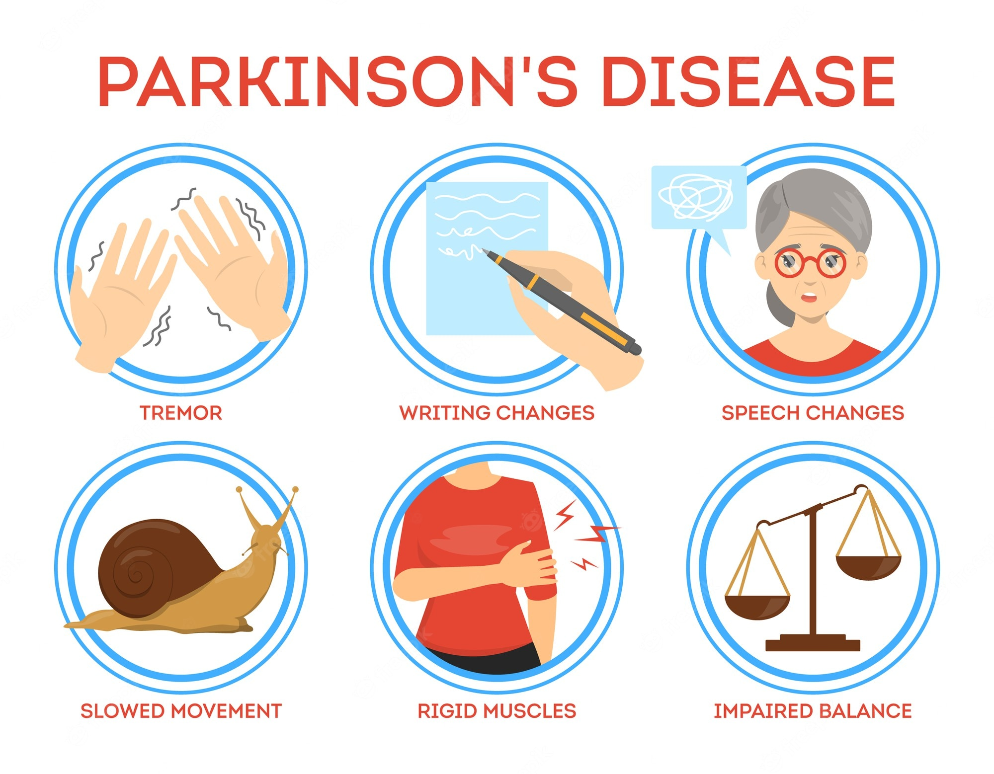
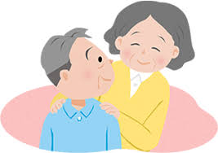
Neurological Illness Patterns: Aging
Deteriorating brain illnesses
Alzheimer’s Disease
Parkinson’s Disease
Stroke-related syndrome

Slide 5
Elderly as a group
Why Elderly?
Reducing physiological vulnerability
Effective management of emotional/cognitive vulnerabilities
Managing co-morbidities
Underlying immune system compromise – cytokine storms
Social isolation
Notes:
Figure 1. A well preserved Babylonian cuneiform Tablet on Epilepsy.
Number 26 in a series of 40 medical “diagnostic” Tablets.
Reproduced by kind permission of the British Museum.
https://i1.wp.com/bshm.org.uk/wp-content/uploads/2017/01/Babylonian-epilepsy.jpg?w=1181&ssl=1

Slide 6
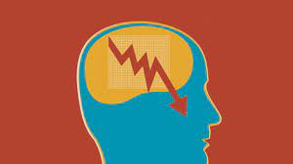
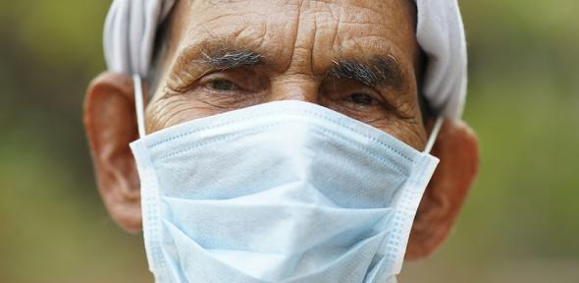
MITIGATING AGAINST COGNITIVE DECLINE IN THE ELDERLY
Immunosenescence
Deterioration
Social Changes
Immune System
due to general physical factors---general health status, nutrient decline
Adaptive vs. Innate
“gradual deterioration of the immune system due to natural aging”
Loneliness, isolation

Slide 7
Biochemical Factors
SGDG
A class of lipids called SGDGs (3-sulfogalactosyl diacylglycerols) that decline in the brain with age and may have anti-inflammatory effects (Nature Chemical Biology, October 22, 2022)
Lipids vital for integrity of neural tissue
Decline in lipids may be a pathway leading to cognitive degeneration

Slide 8
Physical factors
Exercise
Mobility important factor
Quantity vs Quality
Amount vs Intensity

Slide 9
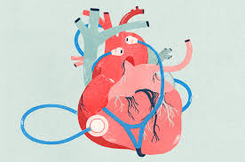
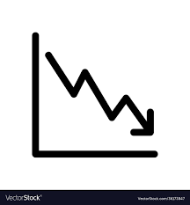
Type of Exercise
Exercise
10 short bouts a week was associated with 16% (cardiovascular disease) and 17% lower risks of cancer
150 minutes moderate exercise---long-held gold standard
Accumulating 2 minutes of vigorous exercise, four times a day---27% lower risk of death

Slide 10
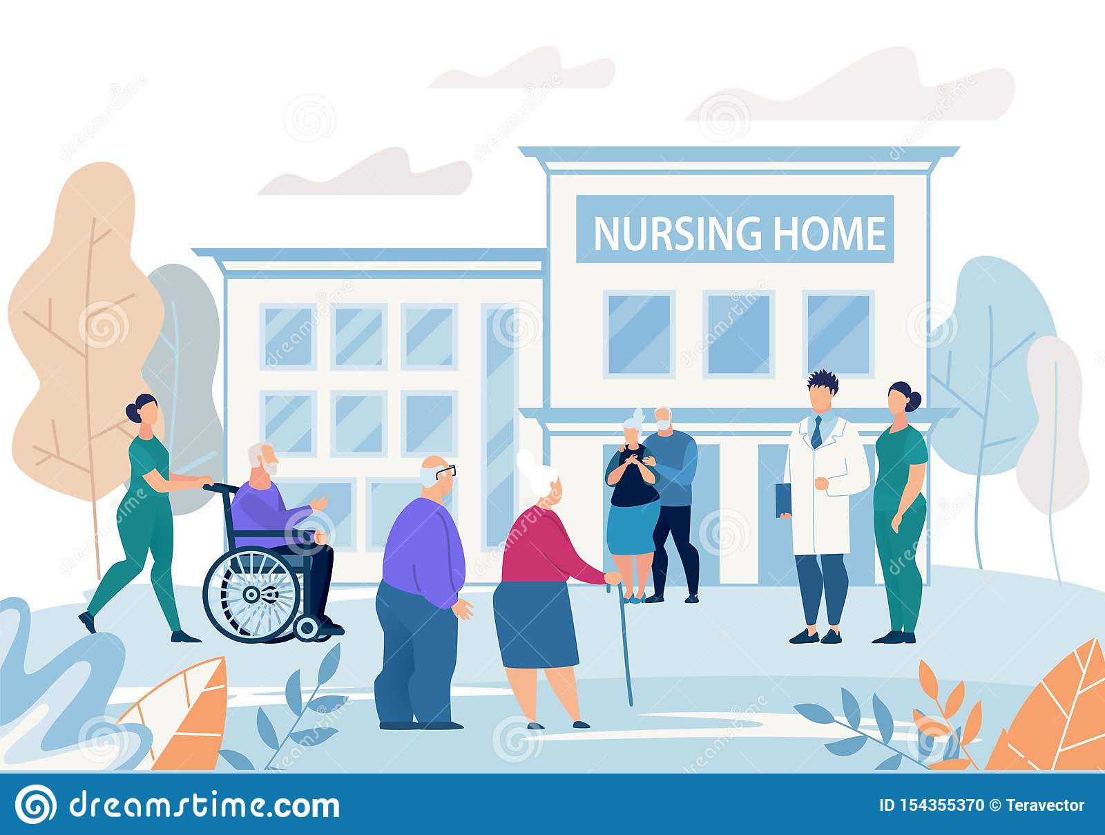
Personality and Use of Healthcare Services
Increased Neuroticism associated with:
Higher use of emergency department
Higher nursing home use
Increased Openness to Experience associated with:
Greater custodial home care
Increased Agreeableness and Decreased Conscientiousness associated with:
Greater custodial home care
Decreased Openness to Experience and Conscientiousness associated with:
Increased emergency department visits (Friedman et al, 2013)
Notes:
Friedman, B., Veazie, P. J., Chapman, B. P., Manning, W. G., & Duberstein, P. R. (2013). Is personality associated with health care use by older adults?. The Milbank Quarterly, 91(3), 491-527.

Slide 11
Implications for Personality “Difficulties”
Personality factors may impact patient-clinician/caregiver relationship
Impact on treatment compliance (Penders et al., 2020)
Exacerbate comorbid mental and physical issues (Penders et al., 2020)
Overall lack of research in assessment, progression, and treatment of personality disorders in older adults
Personality Factors can exacerbate or serve as resiliency factors in older age
Consider individual, person-centered therapy options
Notes:
Penders, K. A., Peeters, I. G., Metsemakers, J. F., & Van Alphen, S. P. (2020). Personality disorders in older adults: A review of epidemiology, assessment, and treatment. Current Psychiatry Reports, 22(3), 1-14.

Slide 12
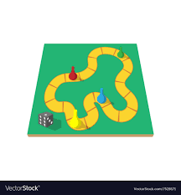
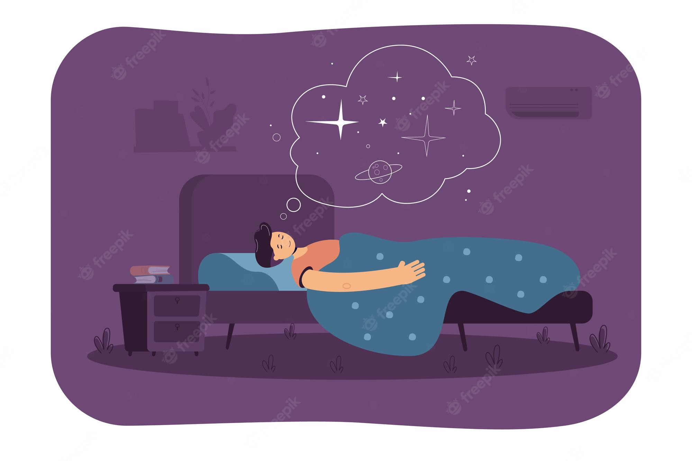
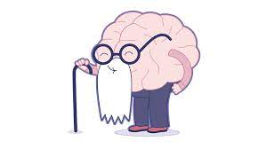
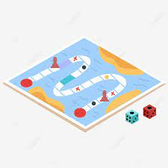
Building Resiliency in the Aging Process
Build physical activities. Short, some intense, some singular, some social
Improve quality of sleep
Improve emotional functioning: Self-examination of emotional functioning for depression.
Improve cognitive alertness and flexibility. Use of boardgames, problem-solving games

Slide 13
What About Personality
Are Personality Traits unmodifiable?
Is there fear of change/resistance to change?
Gentle challenging of personality styles through social interactions with peers using healthy styles of behaviour helpful in counteracting negative traits.

Slide 14
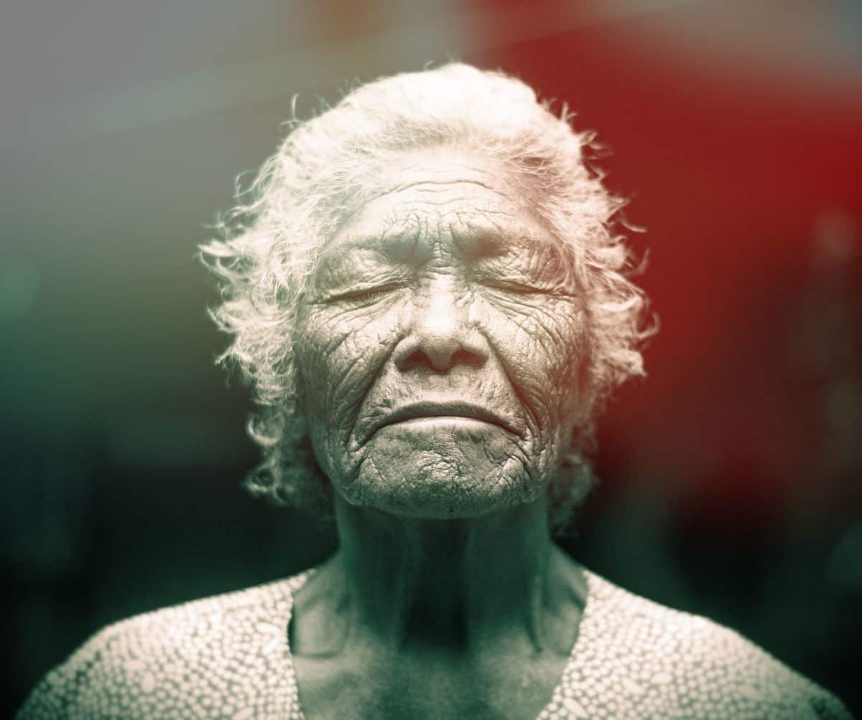
Psycho-spiritual Functioning
Improve positive life reflections
Review spiritual belief systems
Enhance positive psycho-spiritual outlook
Reduce dissonance between spiritual and daily functioning

Slide 15
Thank you for your attention!

